Slide 1
AI-Based Stock Trading Decision System for Apple Inc.
Course Project: Data Science in Practice (August 2024)
Indian Institute of Science, Bangalore
Predict Buy or Sell Decisions Based on Financial Metrics

Slide 2
Team
Ishwer Kumar
Manish Kumar Singh
Bhaskar Garg
Priti Narayan

Slide 3
Introduction & Motivation
Introduction:
Predicting stock price movements for a tech giant like Apple is challenging due to the complex interplay between market sentiment, company performance, and external factors.
Motivation:
1. High Investor Interest: Apple is a market leader, making its stock an attractive target for AI-driven analysis.
2. Data Availability: Apple has a long history of detailed quarterly earnings reports and strong stock price data, offering a rich dataset for AI.
3. Competitive Edge: Using AI to analyze and predict stock movements can offer traders an advantage in terms of profitability and decision-making efficiency.

Slide 4
Problem Statement
Objective:
To create an AI model that makes daily buy or sell recommendations for Apple stock based on today's stock price and the company’s financial performance data (quarterly earnings, profit, loss, revenue).
Challenges:
Volatility: Stock prices can fluctuate significantly due to external events, affecting model performance.
Feature Selection: Identifying which financial metrics most impact stock price predictions.
Market Noise: Short-term movements may not always reflect a company's true performance.

Slide 5
Model Input and Output
Input Features:
Closing price for the day, day’s highest price, day’s lowest price, quarterly revenue, net profit, market cap. etc.
Output Labels:
BUY – indicates we should buy the stock at closing price.
SELL – indicates we should sell the stock at closing price.

Slide 6
Proposed Solution

Slide 7
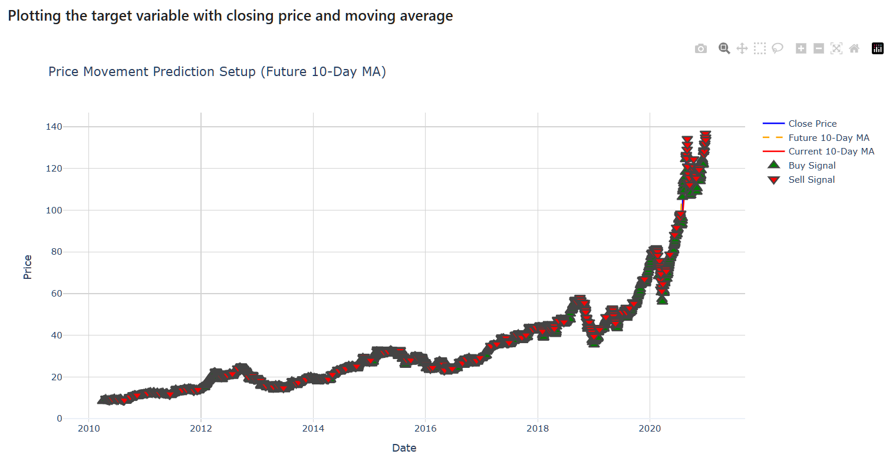
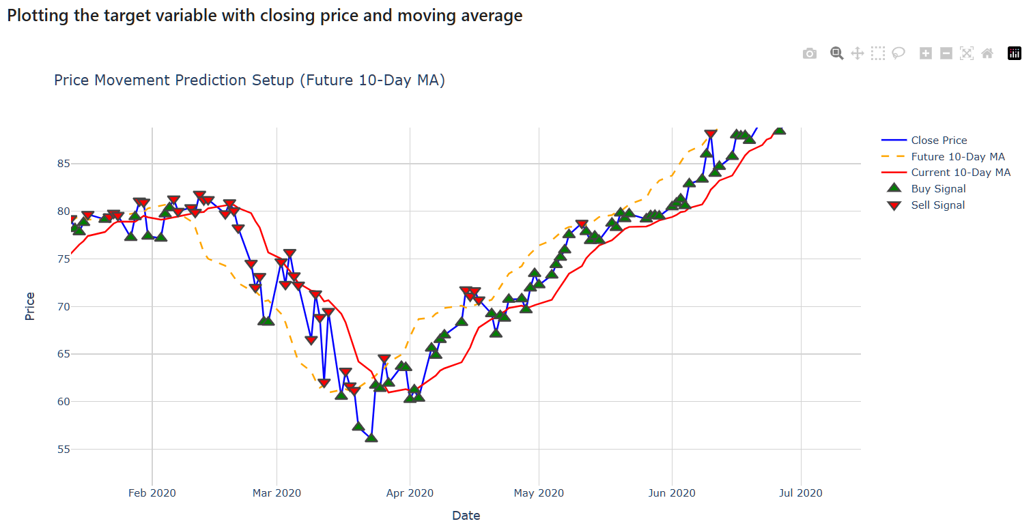
Understanding Target Variable

Slide 8
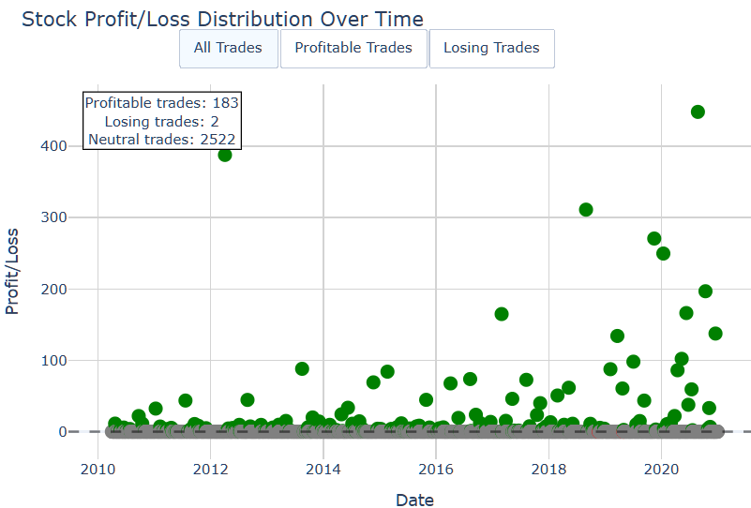
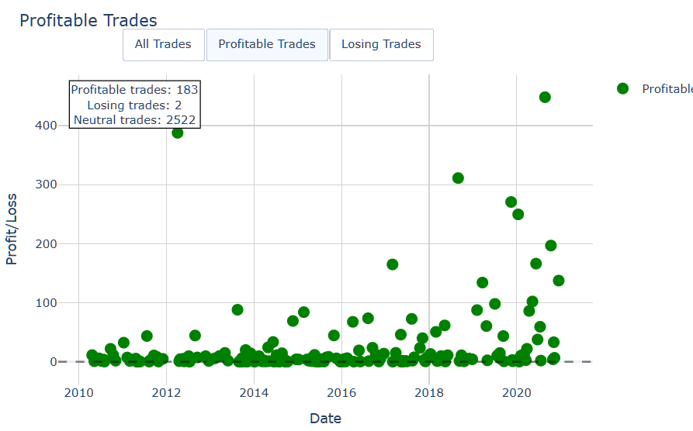
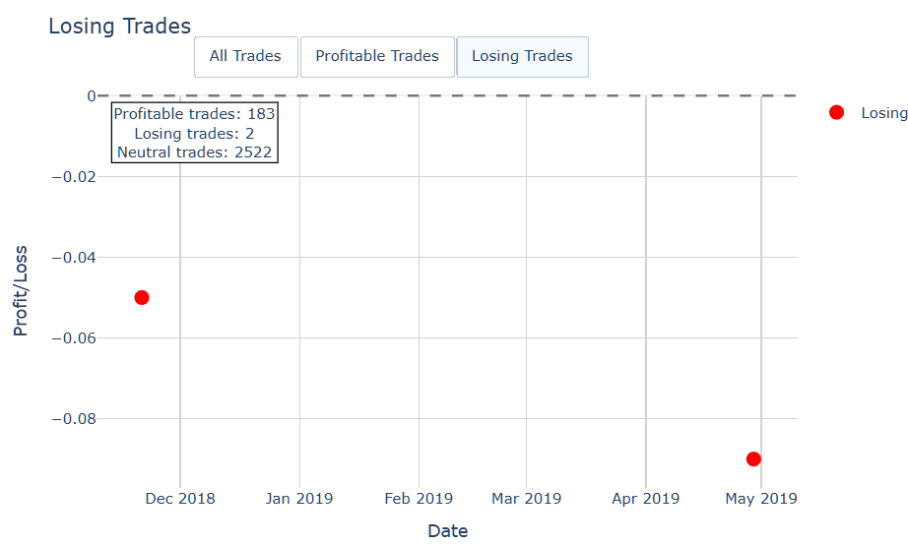
Target Variable : Real world evaluation
Total Profit: 4631.67
Average Profit per Trade: 25.04
Max Profit: 448.06
Max Loss: -0.09
Profit Standard Deviation: 17.34
Number of profitable trades: 183
Number of losing trades: 2
Number of neutral trades: 2522

Slide 9
Step 1: Data Collection
Apple Stock Price Data: Collect historical stock prices from Yahoo Finance (using yfinance package in python).
Apple Financial Data: Gather quarterly earnings reports, profit/loss statements, revenue, and key ratios from SEC filings and financial databases.
We have used below data source available for Apple’s earnings and other financial metrics from quarterly reports (2010-2020):
https://www.kaggle.com/datasets/ryanmaxwell/apple-historical-financial-data

Slide 10
Step 2: Data Preprocessing
Step 2: Data Preprocessing:
Clean and preprocess the financial data (handle missing values, transpose the dataset).
Standardize column names
Remove duplicate columns
Drop null columns
Align stock price data with financial reports to ensure correct temporal associations.

Slide 11
Exploratory Data Analysis (EDA)
EDA Objectives:
1. Analyze Stock Price Trends: Understand historical price movements of Apple stock using time-series plots.
2. Examine Financial Indicators: Look for trends in Apple's earnings, profit, and revenue over time.
3. Correlation Analysis: Measure how key financial indicators like revenue growth, profit margin, and quarterly earnings relate to stock price changes.
EDA Techniques:
Time-Series Visualization: Plot Apple stock price history and moving averages to detect long-term trends.
Correlation Heatmap: Show relationships between financial variables and stock price.
Revenue vs Stock Price: Plot a scatter or line chart to compare revenue growth with stock price movements.

Slide 12
Step 3: EDA & Feature Engineering
Steps:
Analyse the trends in Closing price, net income by plotting corresponding graphs.
Plot 30-day moving average to see if it’s a good indicator for BUY/SELL signals.
Generate additional features like moving averages, P/E ratio, revenue growth, profit margin, etc.
Generate labels BUY/SELL based on next 10 days average closing price.
Analyze the distribution of BUY vs SELL by bar chart and scatter plot.
Calculate cumulative profit if we follow these signals.
Perform correlation analysis between all the columns to find top 10 features.
Perform PCA on all the columns to find top 4 principal components.
Normalize the Close price column.
Convert signal labels column to numeric BUY = 1 or SELL = 0

Slide 13
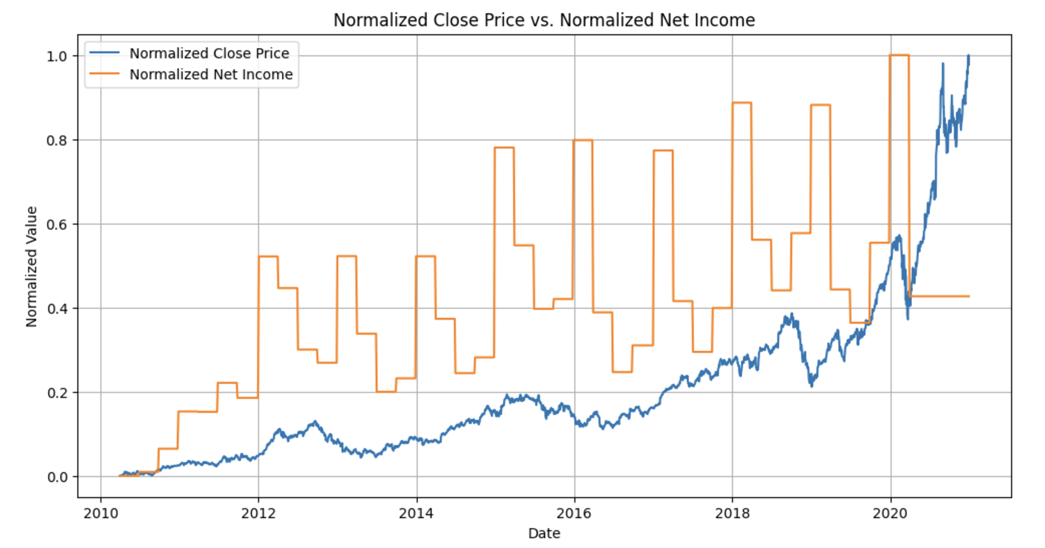
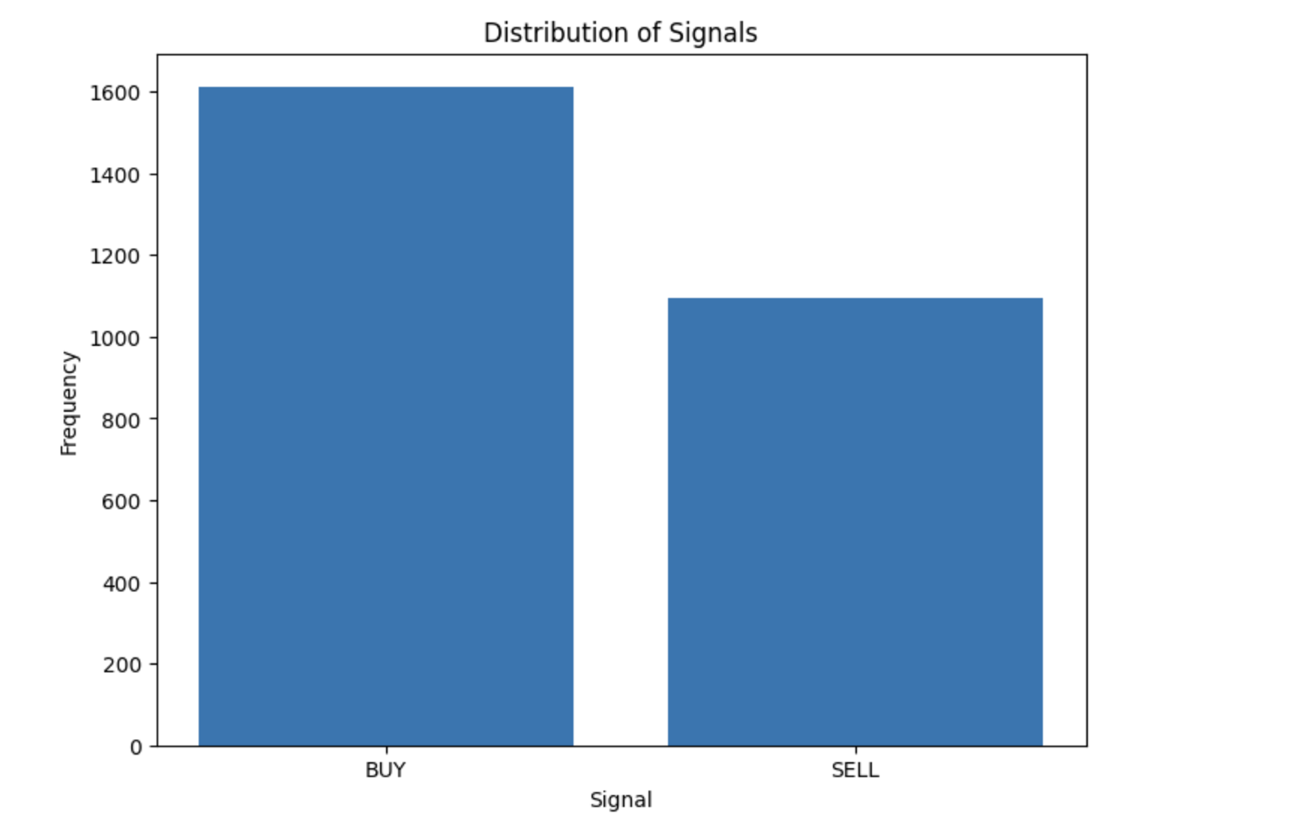
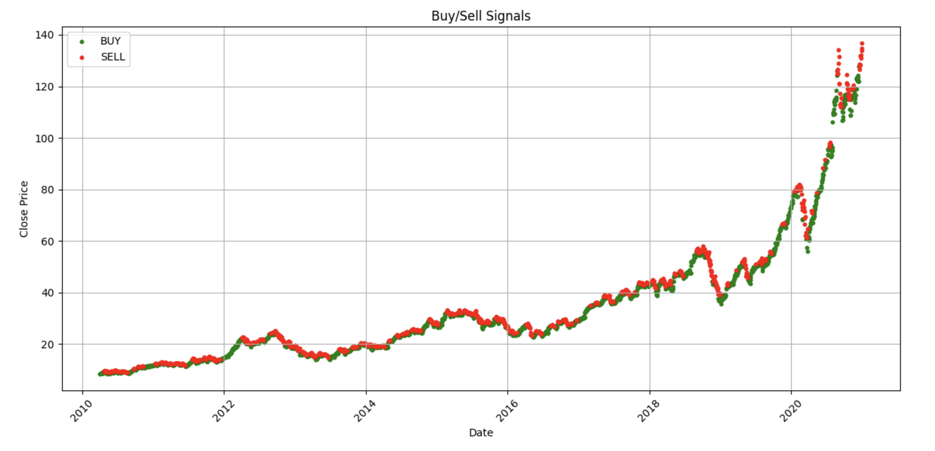
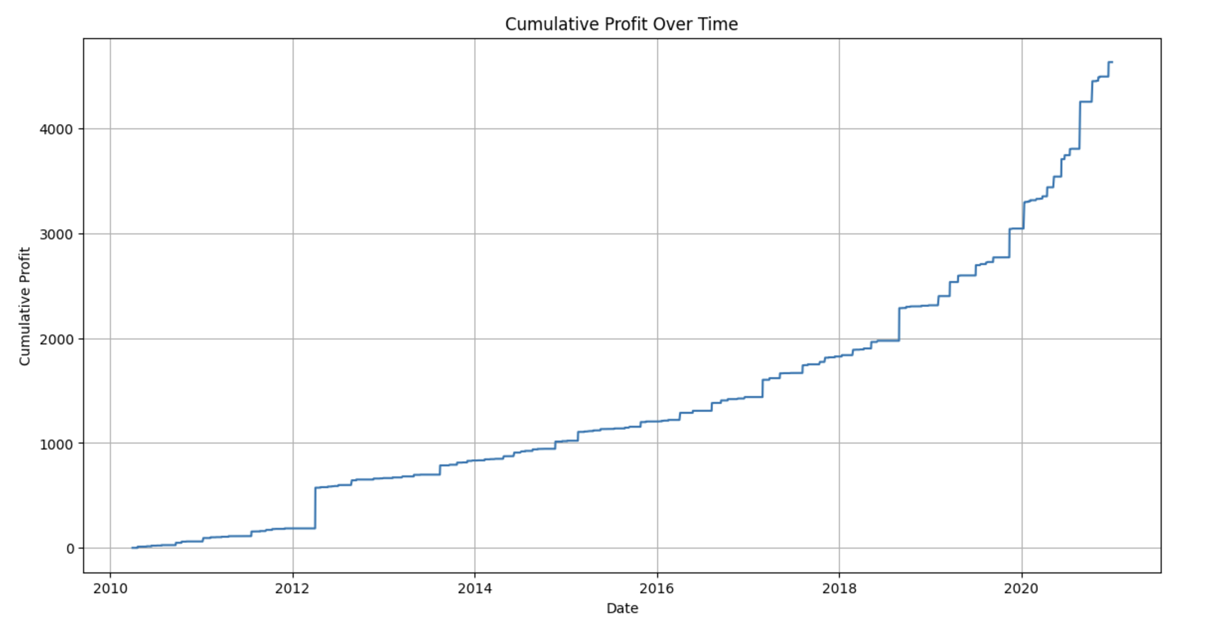
EDA

Slide 14
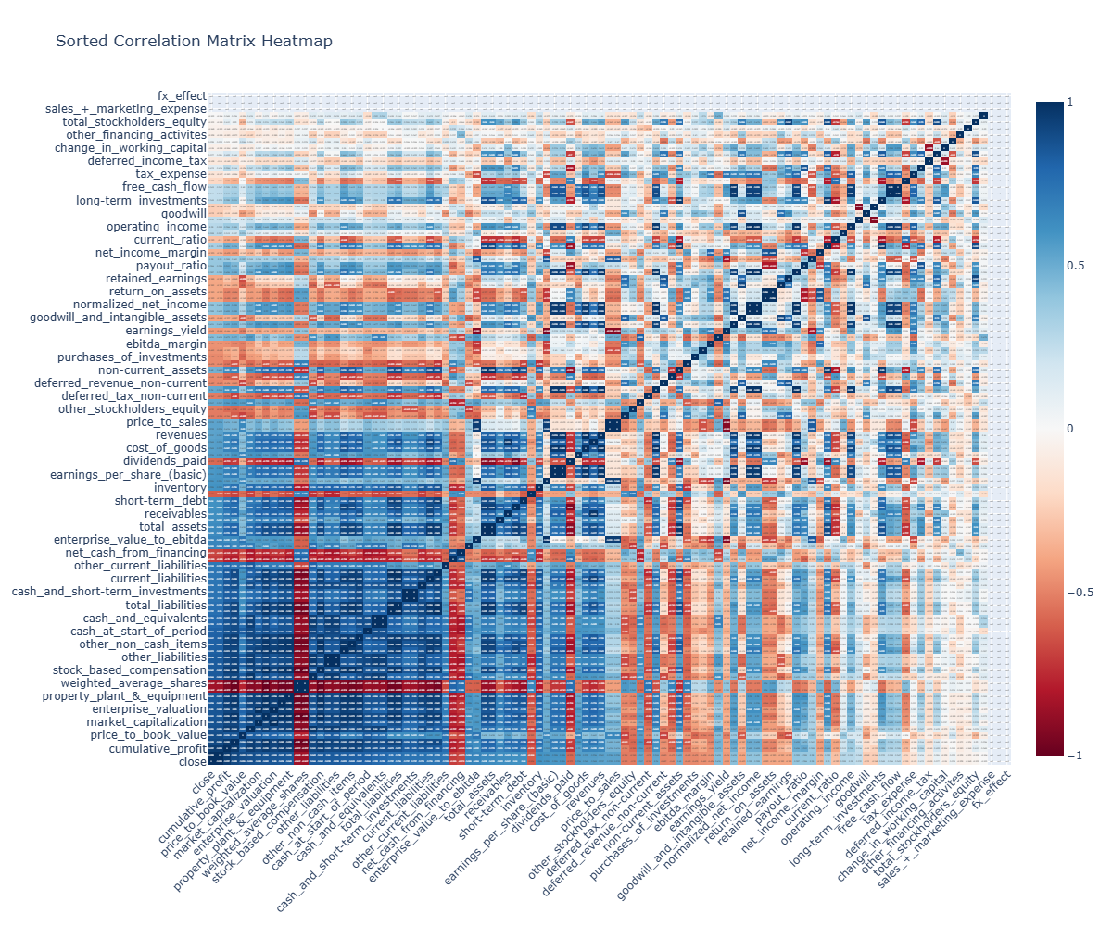
Correlation plot of All available Features

Slide 15
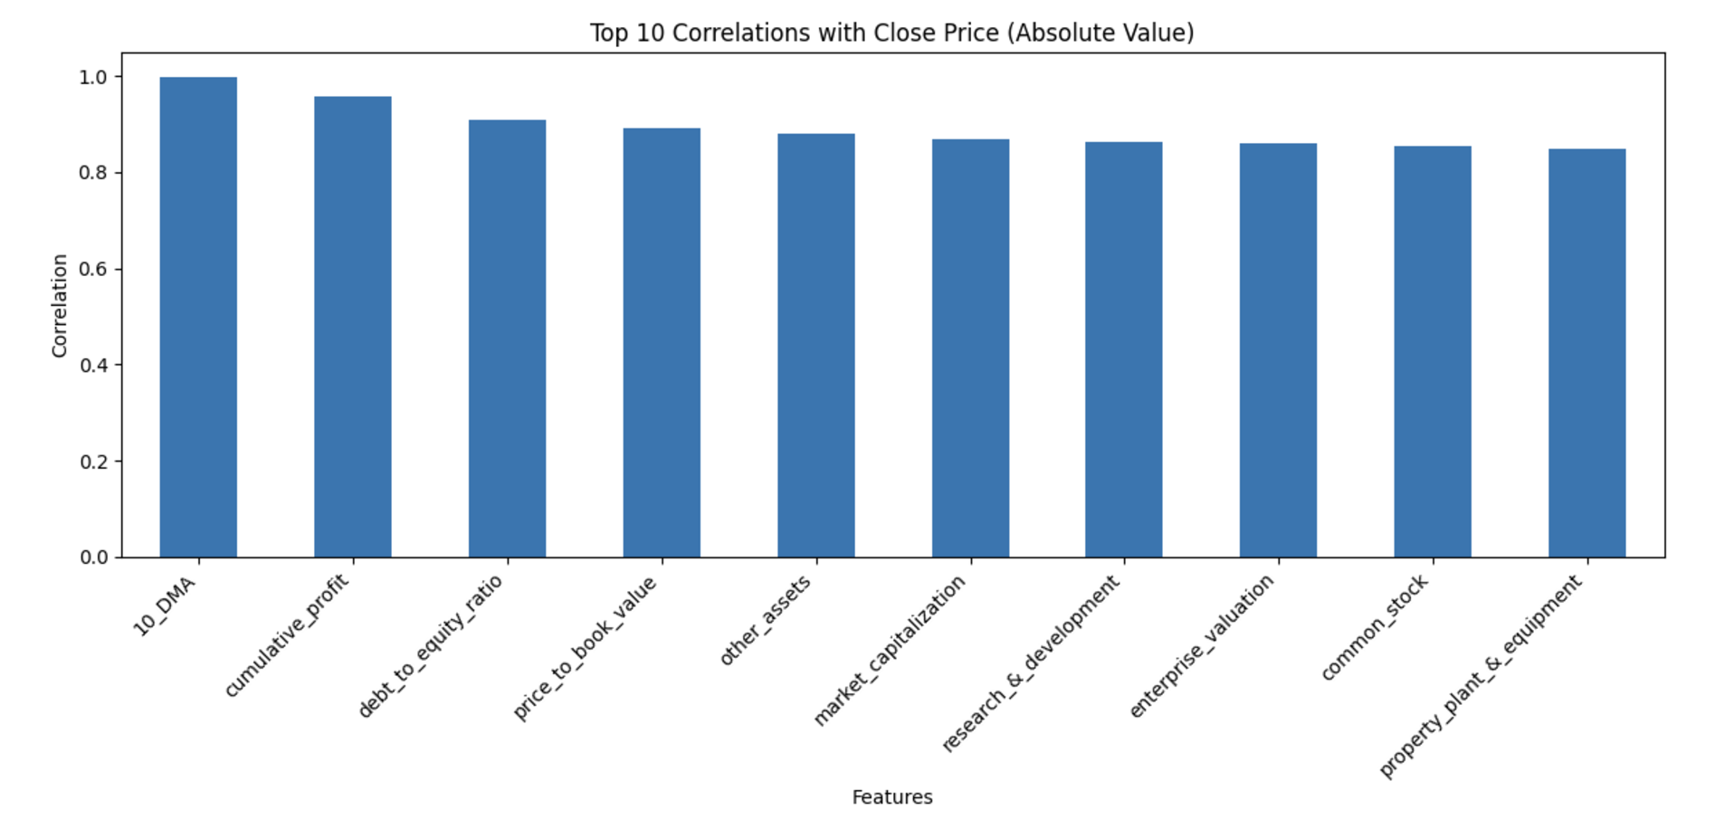
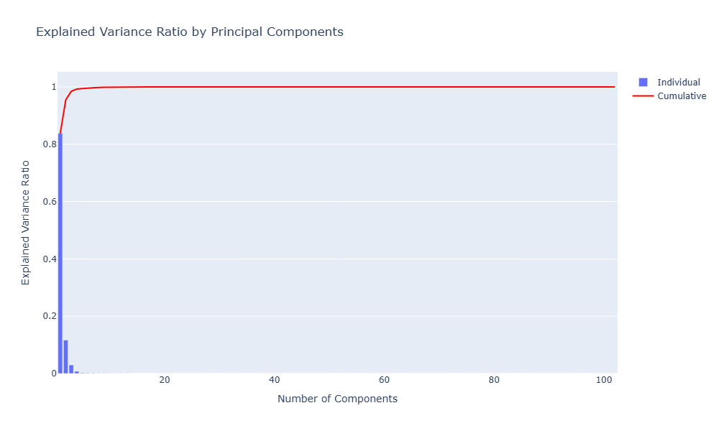
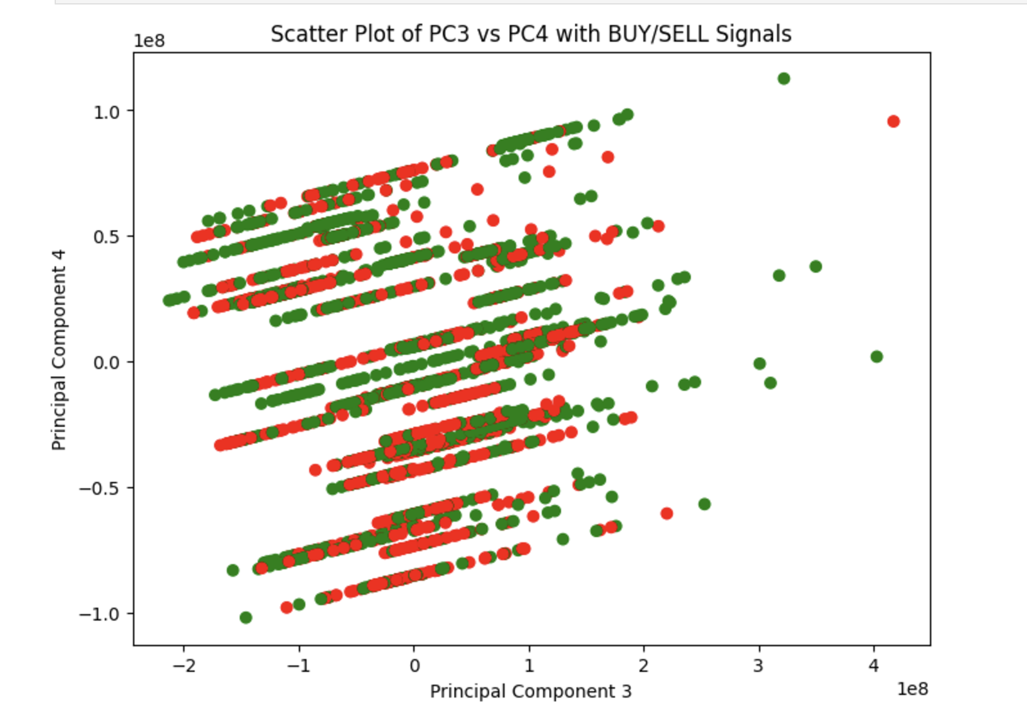
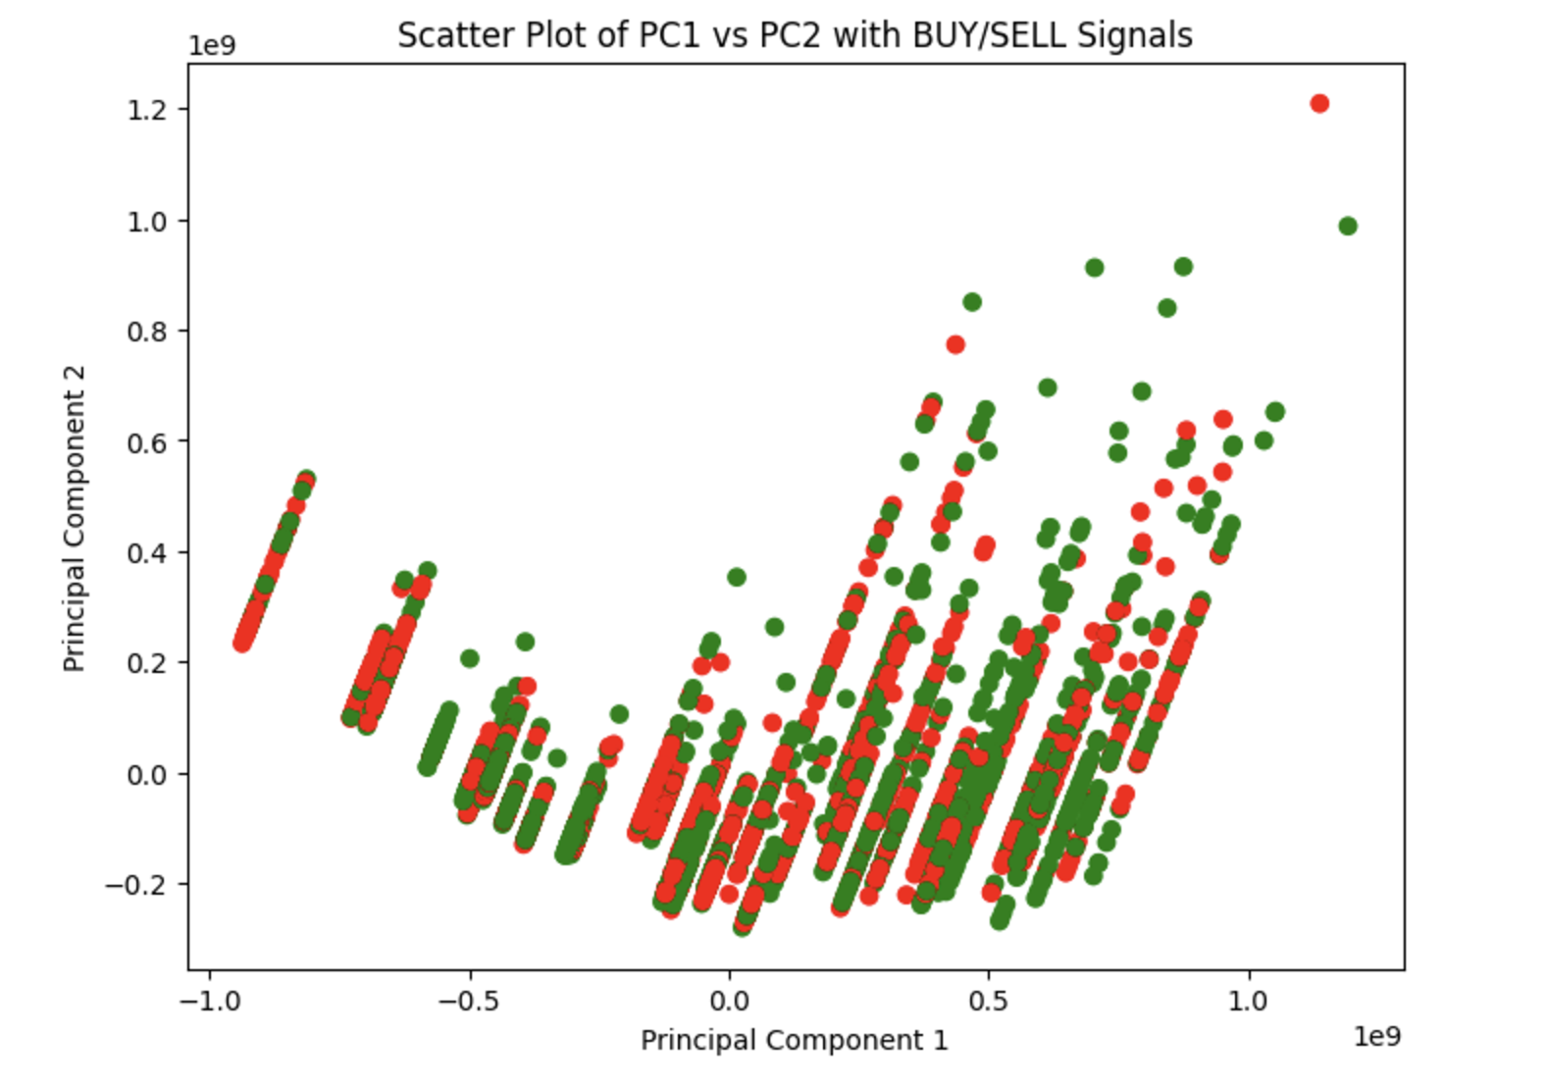
EDA

Slide 16
Performance comparison of all models
 |  | Class 1 (BUY) |  |  | Class 0 (SELL)
Model | Accuracy | Precision | Recall | F1-Score | Precision | Recall2 | F1-Score3
Logistic Regression | 61.0 | 63.0 | 89.0 | 74.0 | 54.0 | 20.0 | 29.0
Random Forest | 73.5 | 74.2 | 76.6 | 75.4 | 72.5 | 69.9 | 71.2
LSTM | 87.4 | 90.7 | 87.1 | 88.9 | 83.3 | 87.8 | 85.5
Random Forest with SARIMAX ensemble | 97.0 | 98.0 | 98.0 | 98.0 | 96.0 | 97.0 | 97.0

Slide 17
Model Architecture
Model Types:
Logistic Regression: For Baseline we first created a simple logistic regression
Random Forest: For robust decision-making with structured financial data and identifying feature importance.
LSTM: To capture time-dependent relationships in Apple’s stock price.
SARIMAX: (Seasonal AutoRegressive Integrated Moving Average with eXogenous variables) is a time series forecasting model that captures seasonality, trends, and external factors for accurate predictions.

Slide 18
Model Architecture
Input Features:
Financial Data: Quarterly earnings, revenue, profit/loss, key financial ratios.
Stock Price Data: Historical prices, moving averages, and volatility metrics.
Output:
Predict "Buy" or "Sell" recommendation for Apple stock the next trading day based on the model's assessment of the input data.

Slide 19
Evaluation Techniques
Model Performance Metrics:
Accuracy: How accurately the model predicts a correct Buy/Sell action.
Precision & Recall: Evaluate precision of profitable buy/sell predictions and recall of missed opportunities.
F1 Score: Balances precision and recall for an overall effectiveness measure.
Financial Performance Metrics:
Profit & Loss Analysis: Measure the profitability of the buy/sell decisions over a simulated period.

Slide 20
Evaluation Techniques
Backtesting:
Use historical stock data for Apple to simulate the performance of the model in past market conditions.
Test the model’s ability to provide profitable recommendations under various market scenarios.
Cross-Validation:
Use k-fold cross-validation to ensure the model generalizes well across different market conditions and is not overfitting to specific time periods.

Slide 21
Step 4: Model Development (Random Forest)
Random Forest Model Overview & Dataset
Purpose: Predict stock signals (BUY/SELL).
Optimization: Use RandomizedSearchCV for hyperparameter tuning.
Goal: Maximize F1-score for balanced precision and recall.
Dataset:
Features (X): Stock-related attributes.
Target (y): BUY/SELL signal.
Split: 80% training, 20% testing.

Slide 22
Step 4: Model Development (Random Forest)
Hyperparameter Tuning & Model Training
Optimized Parameters:
n_estimators, max_depth, min_samples_split, min_samples_leaf, max_features, bootstrap
Tuning Process:
RandomizedSearchCV: 50 iterations, 5-fold cross-validation.
Efficiency: Parallel computation with n_jobs=-1.
Evaluation Metric: F1-score for balanced precision and recall.

Slide 23
Step 4: Model Development (Random Forest)
Model Evaluation
Accuracy: 73.45%
Precision: 74.23%
Recall: 76.60%
F1-Score: 75.39%
Confusion Matrix
True Positives: 72
True Negatives: 58
False Positives: 25
False Negatives: 22
Class-wise Performance
Class 0:
Precision 72.50%
Recall 69.88%
F1-Score 71.17%
Class 1:
Precision 74.23%
Recall 76.60%
F1-Score 75.39%

Slide 24
Step 4: Model Development (LSTM)
Overview:
LSTM (Long Short-Term Memory) is a type of Recurrent Neural Network (RNN) ideal for time-series forecasting, such as stock price prediction.
Why LSTM for Stock Price Prediction?
Handling Sequential Data: LSTM captures temporal dependencies in stock prices, unlike traditional models (e.g., linear regression).
Memory Retention: Retains long-term patterns with mechanisms like cell states and gates.
Handling Noisy Data: LSTM generalizes well over noisy data, making it more robust for forecasting in volatile markets.

Slide 25
Step 4: Model Development (LSTM)
Key Steps:
Data Normalization: Stock prices scaled to a range [0, 1] using MinMaxScaler.
Dataset Preparation: Input (X) - Historical price sequence, Output (Y) - Next day's price.
Train-Test Split: 80% training, 20% testing for model evaluation.
LSTM Model Architecture:
Input Layer: Sequences of historical prices as 3D arrays.
LSTM Layers: Two stacked LSTM layers for capturing complex temporal patterns.
Dense Layer: Fully connected layer for final stock price prediction.

Slide 26
Step 4: Model Development (LSTM)
Model Training:
Loss Function: Mean Squared Error (MSE) for regression.
Optimizer: Adam optimizer for stable and fast convergence.
Training Parameters: 30 epochs, batch size of 32.
Advantages of Using LSTM:
Temporal Awareness: Captures both short-term and long-term dependencies.
Reduced Overfitting: Mechanisms like dropout help mitigate overfitting.
Trend Detection: Effectively models time-series patterns for accurate predictions.

Slide 27
Step 4: Model Development (LSTM)
Model Evaluation
Accuracy: 87.12%
Precision: 90.72%
Recall: 87.13%
F1-Score: 88.89%
Confusion Matrix
True Positives: 88
True Negatives: 65
False Positives: 9
False Negatives: 13
Class-wise Performance
Class 0:
Precision 83.33%
Recall: 87.84%
F1-Score: 85.53%
Class 1:
Precision: 90.72%
Recall: 87.13%
F1-Score: 88.89%

Slide 28
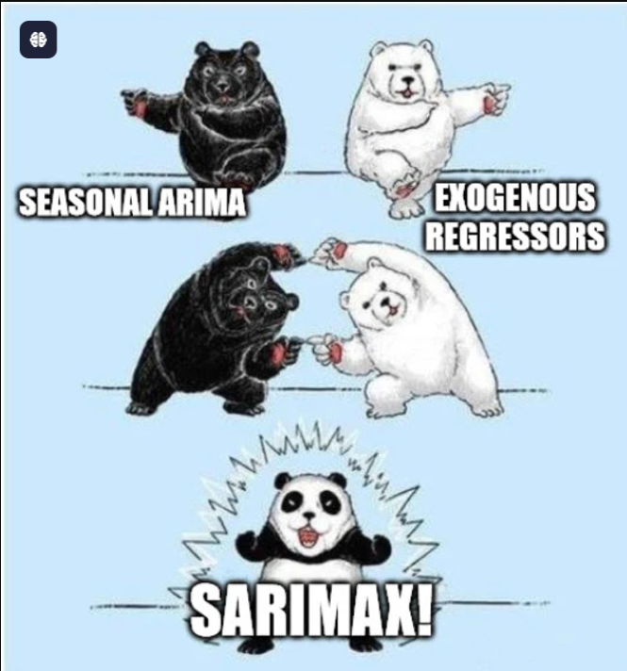
Ensemble(boosting) - SARIMAX with Randomforest
Modelling : First SARIMAX is used to predict shifted 10 days moving average and then the prediction
and its difference is used as features for Random forest model.
SARIMAX :
endog = Next_10_Day_Avg
exog = 'open','high','low',volume,10_DMA,30_DMA,PC1,PC2,PC3,PC4
Random Forest :
close,high,low,open,volume,10_DMA,30_DMA,predicted_10_DMA,price_diff
Two-Stage Prediction
First predicts price movements using SARIMAX
Uses predictions to enhance signal generation using Random Forest

Slide 29
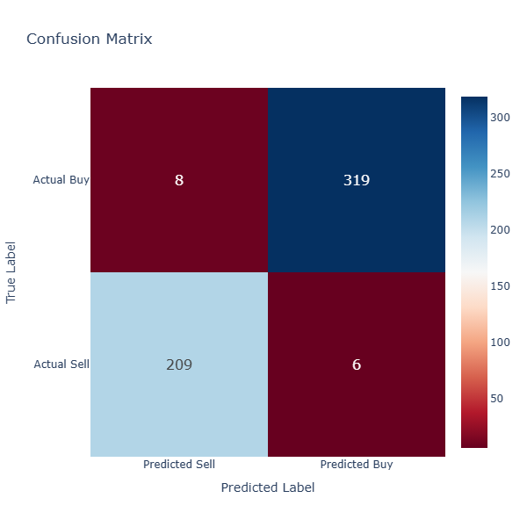
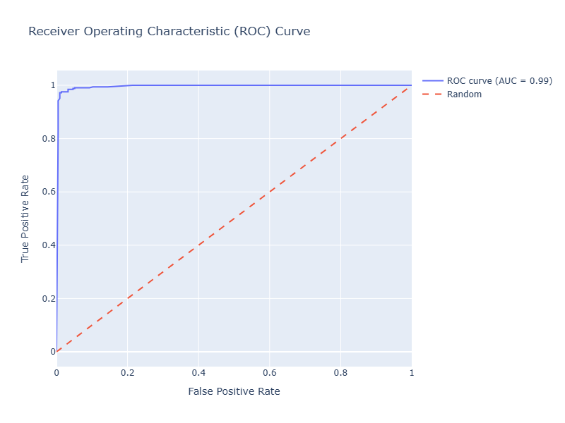
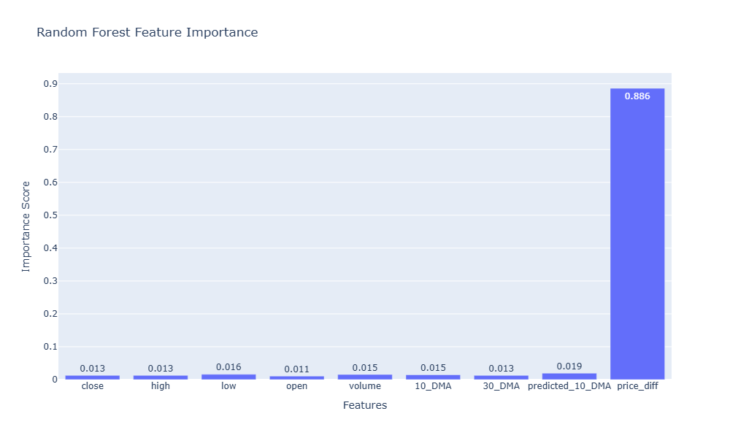
Best Performance (SARIMAX- RF)

Slide 30
Problems & Improvements
Problems we Faced
Data Collection: Companies financial data is not available for past 10 years and api which provides free data has limited history.
Strategy Based Target variable : Implemented a strategy based on MACD but in future when crossover happens and buy till sell signal is predicted
High dimensionality : We started we 100+ features and drill down to top 15 for most of the experiments

Slide 31
Roles and Responsibilities
Ishwer Kumar
Data Collection: Found data source for last 10 years financial data for Apple
Data Preprocessing: Removed null values, normalized columns, generated labels, merged financial data with stock price data from yfinance
EDA: Computed moving averages, plotted the graphs for closing price,
Model Development: Implementing Hyperparameter tuning and cross validation for Random forest, Fitting LSTM model, Random Forest model and SARIMAX model, generated predictions, computed model evaluation metrics
Manish Kumar Singh
Data Collection: Implemented yfinance library to fetch stock price data
EDA: Created profit loss analysis and add PCA components analysis
Model Development: Tried baseline model and Random forest with sarimax , implementation , inference and evaluation.
Bhaskar Garg
• Data Collection: Explored use of apple stock data because of it’s long history and ease of availability.
• EDA: Computed graphs for opening and closing prices, along with the average of high and low of the day.
• Model Development: Running multiple experiments with LSTM Model by changing various hyper parameters and finding correlation with the evaluation metrics.

Slide 32
Further Improvements and Scope
Data Collection: Collecting data for various companies and create more granular model to improve profits
If we tend to continue with this, one can go for the paid api and try the models on a bigger data sets
For smaller data sets like this, we figured out that the model might not be producing right answers because: On experimenting with changing the stock price from close price to open price or high of the day or averages, the results were mostly similar, also increasing the epochs beyond a point(around 10) was not changing the results in LSTM show casing a overfitting of model because of the smaller dataset
Risk Management : Risk management model or some rule based method can be used to mitigate the risk of loss with defined stoploss
We can develop models corresponding to the correlation of how revenue or profits earned by companies affects it’s stock price, with each quarterly and annual earnings release, how the data in the reports affect the stock prices.
Once equipped with such data, we can make better judgements on using LSTM, Random Forest or so…
Modeling: Can add ensemble method with LSTM and Random forest or XGBoost and see if its performs well for different stocks

Slide 33
Conclusion
While the current model has been successful in generating buy/sell signals for Apple, its future lies in broadening its scope to include other stocks, industries, and asset classes. This expansion will empower investors with more comprehensive insights, enabling better risk management, diversified portfolio strategies, and a competitive edge in dynamic financial markets.

Slide 34
Data Science Canvas |  |  | Project: | Apple Stock BUY/SELL Decision Prediction
 |  |  | Team: | Ishwer Kumar / Manish Kumar Singh / Bhaskar Garg / Priti Narayan
Problem Statement |  |  |  | Execution & Evaluation |  | Data Collection & Preparation
Business Case & Value Added Predicting stock BUY/SELL signals for Apple to increase the overall profit for investors. | Model Selection The model should be able to handle sequential data and make predictions accordingly. For that purpose, we have used a few timeseries methods and ensemble methods to capture the trend. Below are the models which we have tried: Random Forest LSTM SARIMAX | Model Requirements Model should be able to handle sequential data with better than average precision and recall. Also, the predictions should be generated quickly. | Skills A brief knowledge about how stock market operates would be helpful to come up with useful features, analyze the output of EDA and to generate proper metric for model validation. Along with that, programming knowledge, fundamentals of Data Science and skills in Ensemble methods and neural networks is required. | Model Evaluation To validate the model’s performance, we can use Precision Recall F1 – Score To measure the impact, we can calculate the overall profit earned on the predictions. | Data Storytelling Our basic assumption is that, over time, the stock price should move according to the financial metrics of the company. For example, if the overall revenue, profit and market cap of company is moving up, the stock price itself should eventually move up. | Data Selection & Cleansing After correlation analysis, we have found the top 10 features which are highly correlated to the BUY/SELL signal some of which are, profit, market cap, revenue etc. | Data Collection We are mainly relied on two data sources, one is the stock price data for each day and quarterly earnings data. Each day has the data from previously available quarterly earnings report.
Data Landscape The stock closing price is already available. We had to collect the quarterly earnings data for the past decade. |  | Software & Libraries To run this model, we can use latest version of Python with below required libraries: pandas numpy Matplotlib Seaborn Scikit-learn Yfinance plotly |  |  |  | Data Integration We are mainly relied on two data sources, one is the stock price data for each day and quarterly earnings data. Each day has the data from previously available quarterly earnings report. | Explorative Data Analysis Finding the correlation between stock closing price and profit, revenue and market cap etc. Computing principal components Analyzing the label distribution
Adopted from: https://github.com/tomalytics/datasciencecanvas

Slide 35
Thank you!

